Slide 1
Functional Interfaces & Lambda Expressions

Slide 2
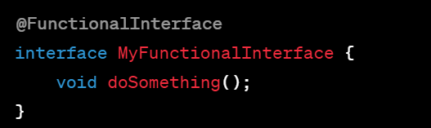
Overview
In Java, functional interfaces and lambda expressions are key features introduced in Java 8 to support functional programming and enable more concise and expressive code.
Functional Interfaces: A functional interface is an interface that contains only a single abstract method. It serves as a contract for a functional expression or lambda expression. Java provides the @FunctionalInterface nnotation to explicitly declare an interface as functional, although it's not mandatory.

Slide 3
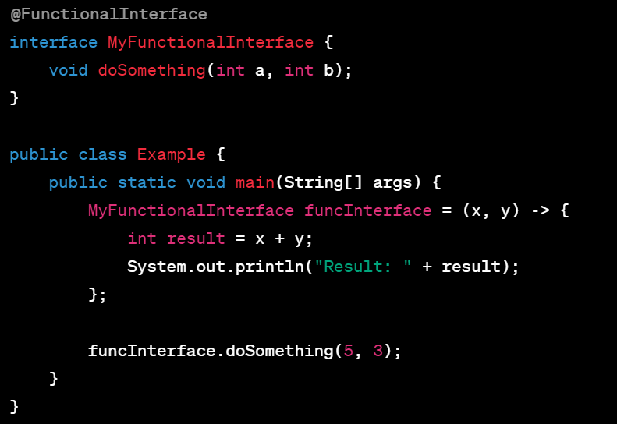
Lambda Expressions
A lambda expression is an anonymous function that can be used to provide a concise implementation of a functional interface. It allows you to write more compact code by reducing the need for explicit anonymous class implementations. The syntax of a lambda expression consists of the parameter list, the arrow token -> and the body. The body can be a single expression, or a block of statements enclosed in curly braces.

Slide 4
It's important to note that lambda expressions are applicable only to functional interfaces. The lambda expression must match the method signature of the abstract method in the functional interface, providing a compatible implementation.

Slide 5
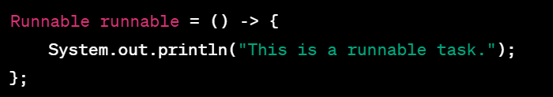

Using Lambda Expressions
With Runnable
Here the expression ()->{…} represents the implementation of the run() method. When invoked, it executes the method inside the lambda body
Using Lambda Expressions with Comparator

Slide 6
Variable Capture in functional interface
Variable capture in functional interfaces refers to the ability of lambda expressions to access and use variables from their surrounding context. When a lambda expression uses variables from the enclosing scope, those variables are effectively "captured" and made available inside the lambda body.
There are two types of variable capture in lambda expressions:
Accessing Local Variables
Accessing Instance Variables and Parameters

Slide 7
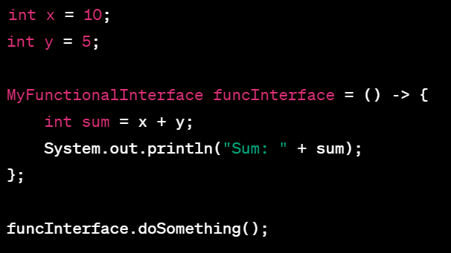
Accessing Local Variables
Lambda expressions can access final or effectively final local variables from the enclosing scope. An effectively final variable is one that is not explicitly declared as final but its value does not change after initialization. The lambda expression can read the value of these variables but cannot modify them.

Slide 8
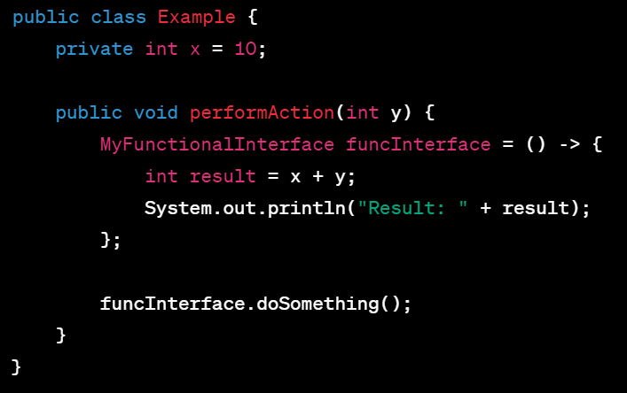
Accessing Instance Variables and Parameters
Lambda expressions can also access instance variables and method parameters of the enclosing class or method. Unlike local variables, these variables do not need to be declared as final or effectively final.

Slide 9
Please note that when a lambda expression accesses a local variable or an instance variable, it captures the variable itself, not its value. This means that if the variable changes its value after the lambda expression is created, the lambda will use the updated value when executed.

Slide 10
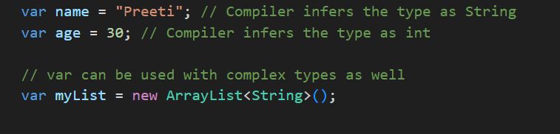
Type Interface
In Java, the concept of "type interface" refers to the ability of the Java compiler to infer the type of a variable based on the assigned value. This feature was introduced in Java 10 and is known as "var.“ With type inference using "var," you can declare a variable without explicitly specifying its type, and the compiler will determine the appropriate type based on the assigned value. The type is inferred at compile-time and remains static throughout the variable's scope.

Slide 11
In this example, the type of the variables name, age and myList is inferred by the compiler based on assigned values. The compiler determines name as String, age as int and myList as List<String>
Although, "var" allows for type inference, the inferred type is still statically typed. The type is determined at compile-time and cannot change during runtime. Once the type is inferred, it is as if you explicitly declared the variable with the inferred type.
"var" cannot be used for method parameters, return types, or fields. It is only applicable for local variables within a method or block.

Slide 12
Benefits of Type interface
Type inference with "var" provides a balance between static typing and code conciseness. It allows you to write cleaner and more readable code by reducing the verbosity of type declarations while still maintaining the benefits of static typing and compile-time type checking.

Slide 13
Method References

Slide 14
Overview
Method references provide a way to simplify the use of functional interfaces when the lambda expression only calls a single method. They can make the code more readable and reduce the noise of lambda expressions. By referencing existing methods or constructors, method references allow you to reuse code and make it more modular.
Method reference are of 4 types –
Reference to a Static Method
Reference to an Instance Method of a Particular Object
Reference to an Instance Method of an Arbitrary Object of a Particular Type
Reference to a Constructor

Slide 15
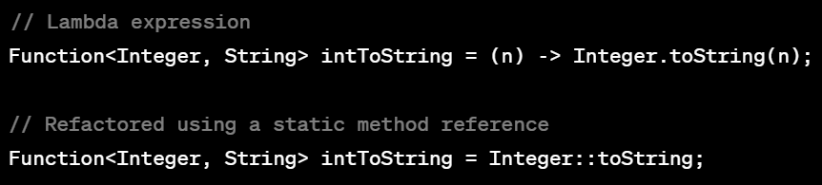
Method References explained and compared with Lambda code
Reference to static method
Here, static method toString() of the Integer class is referenced using Integer::toString. The method reference is assigned to functional interface which takes integer as an input and returns String as output.

Slide 16
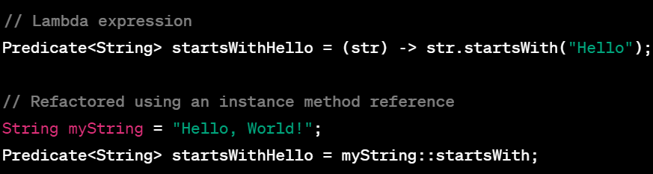
Reference to an Instance Method of a Particular Object
Here, startsWith method of String class is referenced using myString::startsWith method reference. It is then assigned to a Predicate functional interface , which tests if the string starts with specific value.

Slide 17
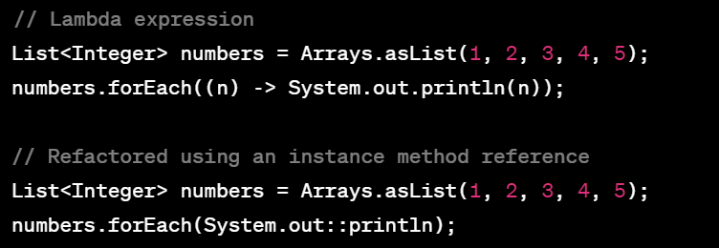
Reference to an Instance Method of an Arbitrary Object of a Particular Type
Here, the println method of PrintStream class (represented by System.out) is referenced using System.out::println. This is then used in the forEach method of the List interface to print each element of List

Slide 18
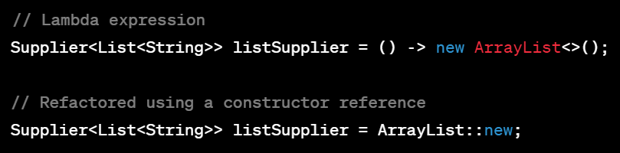
Reference to a Constructor
Here, the constructor of the ArrayList is referenced using ArrayList::new method reference. The method reference is assigned to a Supplier functional interface , which supplies new instance of ArrayList
Note - Not all lambda expressions can be refactored into method references. Method referenc Bes have specific restrictions, such as the method

Slide 19
Streams

Slide 20
Why Streams?
Streams in Java provide a powerful and expressive way to process collections of data or sequences of elements. Streams allow you to perform various operations on data, such as filtering, mapping, reducing, and sorting, in a functional and declarative style.

Slide 21
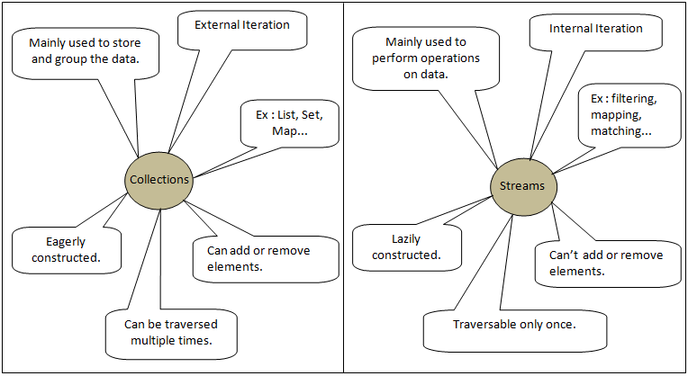
Streams VS Collections

Slide 22

Anatomy of Stream
Data Source:
The data source is the origin of the stream. It can be a collection, an array, an I/O channel, a generator, or any other source that provides a sequence of elements to be processed.
Stream Creation:
To create a stream, you typically call a method on the data source, such as stream() or parallelStream(). This converts data into stream representation.
Streams can be created by
1. Stream from a collection

Slide 23

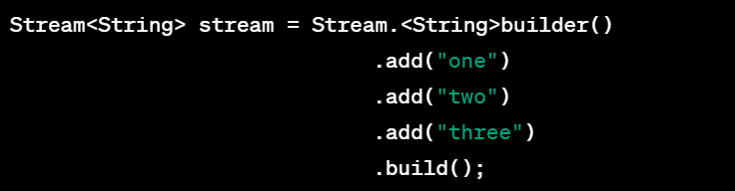
Stream from Array
Stream from Static Value
Stream Builder

Slide 24

Stream generate
Stream iterate
Stream from Files

Slide 25
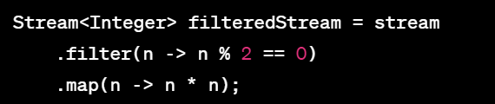
3. Intermediate Operations
Intermediate operations are operations that transform or filter the stream elements. They are chained together and applied sequentially to the stream. Examples of intermediate operations include filter(), map(), distinct(), sorted(), limit(), skip(). These operations take stream as input and return stream as output

Slide 26

4. Terminal Operations
A terminal operation is the final operation that produces a result or performs an action on the stream. It triggers the processing of the stream and consumes the elements. Examples of terminal operations include min(), max(), reduce(), forEach(), collect(), count(), anyMatch(). Once a terminal operation is invoked, the intermediate operations are executed, and the result is produced.
Pipelining
Streams allow for method chaining, creating a pipeline of operations. This enables you to perform multiple operations on the stream in a concise and readable manner.
Each intermediate operation returns a new stream, which allows for further operations to be applied. The result is a series of transformations and filters applied to the original data.

Slide 27
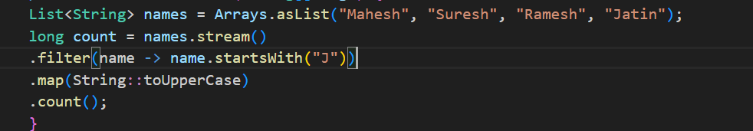
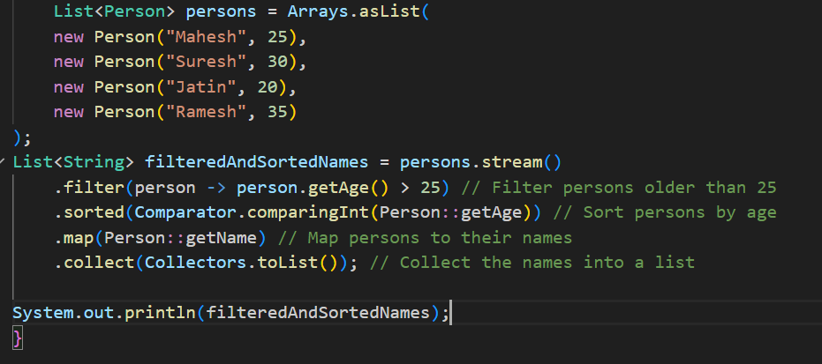
Pipelining example
Filter(), sort(), map() example
→ [Suresh, Ramesh] Ramesh’

Slide 28
Stream operations
Intermediate
filter(Predicate<T> predicate): Filters the stream based on a predicate. Only elements that satisfy the given predicate are included in the resulting stream.
map(Function<T, R> mapper): Transforms each element of the stream by applying the provided mapping function to it. It returns a new stream consisting of the results of the mapping function applied to each element.
flatMap(Function<T, Stream<R>> mapper): Transforms each element of the stream into a stream of other elements. The resulting streams are then flattened into a single stream.
distinct(): Returns a stream consisting of distinct elements from the original stream. Duplicate elements are removed.
sorted(): Sorts the elements of the stream in natural order. For objects that do not implement the Comparable interface, a custom comparator can be provided.

Slide 29
skip(long n): Returns a stream consisting of the remaining elements of the original stream after discarding the first n elements.
peek(Consumer<T> action): Performs an action on each element of the stream without modifying the stream. It can be used for debugging or logging purposes.
takeWhile(Predicate<T> predicate): Returns a stream consisting of the longest prefix of elements from the original stream that satisfy the given predicate. It stops once an element that does not satisfy the predicate is encountered.
dropWhile(Predicate<T> predicate): Returns a stream consisting of the remaining elements of the original stream after dropping the longest prefix of elements that satisfy the given predicate. It stops once an element that does not satisfy the predicate is encountered.
unordered(): Returns an unordered stream. It may not preserve the order of the elements in the resulting stream.
limit(long maxSize): Returns a stream consisting of the first maxSize elements of the original stream.

Slide 30
Terminal operations
forEach(Consumer<T> action): Applies an action to each element of the stream. It can be used to perform an operation on each element, such as printing or updating values.
count(): Returns the count of elements in the stream as a long.
collect(Collector<T, A, R> collector): Performs a mutable reduction operation on the elements of the stream using a Collector. It collects the elements into a container or performs some other mutable side-effect.
toArray(): Converts the stream elements into an array.
reduce(BinaryOperator<T> accumulator): Performs a reduction on the elements of the stream using the provided binary operator. It combines the elements of the stream into a single result.
min(Comparator<T> comparator) and max(Comparator<T> comparator): Returns the minimum and maximum element of the stream based on the provided comparator, respectively.
anyMatch(Predicate<T> predicate), allMatch(Predicate<T> predicate), and noneMatch(Predicate<T> predicate): Check if any, all, or none of the elements in the stream match the provided predicate, respectively.
findFirst() and findAny(): Returns an optional containing the first element and any element of the stream, respectively.

